Slide 1
Analysing Open Source Software to Better Understand Long Term Memory Structures in the Human Brain
Thomas Mullen
Notes:
(Gentner’s Systematicity principle9 )
Gentner D. Structure-mapping:a theoretical framework for analogy. Cognitive Science 1983, 7:155–170.
Higher-order relations play an important role in analogy, as is discussed below.
N
system can be represented by an interconnected predicate structure in which higher-order predicates enforce connections among lower-order predicates.’

Slide 2
Conjecture
Link between :
  Dependency graph of variables in the code
  Software language structures chosen to represent them
Notes:
In a short while I’ll be introducing a general refactoring algorithm.
Just to set the scope. When we develop code, we identify variables and dependencies that will make the application behave as the requirements need it to. Even once that is decided there are number of ways that we can represent the same dependency graph.

Slide 3
Conjecture
Link between :
  Dependency graph of variables in the code
  Software language structures chosen to represent them
Software structure chosen by developer is a close representation of the long-term memory structure in their brain for the dependency graph.
Notes:
The central conjecture is that…

Slide 4

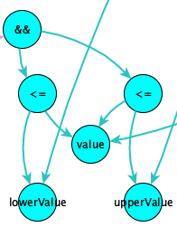
30,000 ft view argument
Software Language
Notes:
I’ll go into more detail of the elements of long-term memory structures in a little while, but from a 30,000 foot point of view there is an argument that this makes sense.
Whenever we understand and learn anything, the endgame is that we lay down long-term memory.
Only then can we utilize that knowledge, extended and build on it and even apply to other domains thus gaining extra insight of those domains.
So, if we had a choice of how to represent something (in our case the dependency graph) and the primary reason is to make it easier to understand, then the closer our representation gets to long-term memory structures the less translation is needed.

Slide 5
30,000 ft view argument
natural
language
Cognitive Linguists
Notes:
This is also true of natural language. So, for example, if you have researched something and come to an understanding and wanted to pass that knowledge on to me. You would first access the long-term memory of that knowledge and serialise it in the form of natural language. I would then take those sentences & paragraphs, deserialise it and hopefully lay down the same long-term structures that are in your brain. Thus, understanding what you know without the cost of having to research it.
Indeed, that’s what cognitive linguist do. They analyse natural languages to see if they betray how the mind works.
If natural languages are the serialization of long-term memory structures, then software languages are the direct access equivalents (albeit for the niche case of dependency graphs).
So, there is a high-level argument for the conjecture that software structures are long-term memory structures.

Slide 6
Long-Term Memory & Software Structures
Chunks
Analogies
Notes:
A more detailed layer of validation is from a 2009 paper I wrote which identified the elements of long-term structures that have closed parallels to software design principles and software languages.
Specifically, this involves two elements of long-term memory: chunks and analogies.

Slide 7
Chunks
“memory elements are grouped together so that elements within a chunk are strongly related to one another but loosely related to elements in other chunks”
Notes:
The cognitive psychologist’s definition of chunking is that memory elements of group together so that elements within a chunk are strongly related to one another but loosely related to elements of chunks. This is very similar to the coupling and cohesion principles that were developed as part of the structure design methodology in the 60s and 70s.

Slide 8






Chunks
“memory elements are grouped together so that elements within a chunk are strongly related to one another but loosely related to elements in other chunks”
cohesion
coupling
Notes:
The cognitive psychologist’s definition of chunking is that memory elements of group tosgether so that elements within a chunk are strongly related to one another but loosely related to elements of chunks. This is very similar to the coupling and cohesion principles that were developed as part of the structure design methodology in the 60s and 70s.

Slide 9
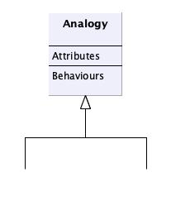
Analogies
Analogy is at the core of higher-order cognition. As Douglas Hofstadter puts it, “Analogy is the engine of cognition.” Analogical thinking enters into creative discovery, problem-solving, categorization, and learning and transfer
Gentner & Smith (Encyclopedia of Human Behavior)
Notes:
Analogical reasoning is a huge topic and, for many cognitive psychologists, analogies are at the heart of human intelligence. Gentner’s structure mapping theory defines an analogy as a mapping between two or more objects or domains. The mapping has attributes and behaviours, where the behaviours combine attributes and other behaviours.
This is very similar to the class description developed as part of the object-oriented paradigm in the 70s and 80s. Although as the 2009 paper identified there are number of different ways we can represent analogies in code. The code snippets at the start of the presentation showed a couple of ways.
The similarity between how cognitive psychologists describe long-term memory structures and the principles that underpin software design and software languages gives further validation to the conjecture that software structures are long-term structures.

Slide 10
So What?
Notes:
In a little while, I’ll describe the the refactoring algorithm that will hopefully provide more detail validation of this conjecture.
However, just to take a little aside…. even if we were to assume that the conjecture was true at this stage, so what?
If human intelligence has benefited from the efficiency and performance of long-term memory structures, then perhaps AI models could also benefit. The way we train AI models may already be building these structures. For example, Hollyoak has identified the ChatGPT exhibited the behaviour of analogical reasoning.
A deeper understanding of long term memory structures would be key to recognizing them in AI models and possibly improve the process of creating them.
If the conjecture is true, then open source would provide a huge database of potentially searchable examples of long-term memory structures for the dependency graphs which they represent.
At some stage, AI models may communicate with one another to share knowledge, so that costly training doesn’t need to be repeated.

Slide 11
So What?
????
language
Data Scientists
Notes:
If AI models utilize long-term memory structures then, like natural languages and software languages, the language they communicate with, will likely be based on long-term memory structures. Understanding long-term memory structures will allow us to eavesdrop on those conversations and potentially influence them. (So that biases or errors in the data training can be corrected).
If long term memory structures are important in ai then gaining a deeper understanding of them can only help
That’s the reason for the refactoring algorithm. Not to create a refactoring tool of use to developers. Rather, to provide further validation of the conjecture , and also to build the tools that can be used to analyse open source…

Slide 12
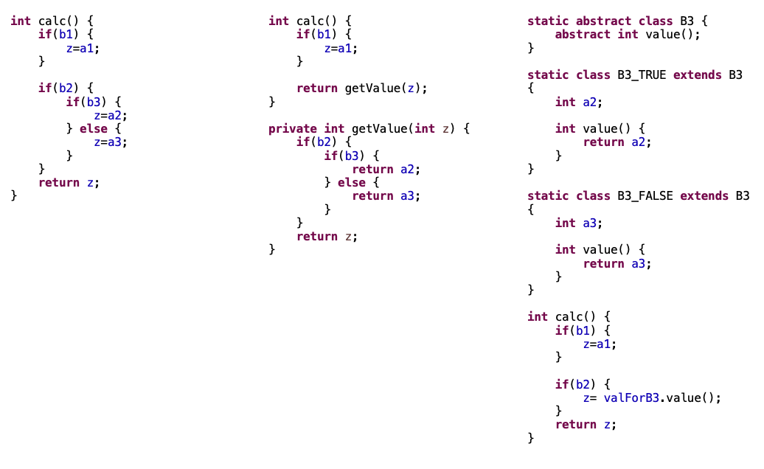
Z = f(a1,a2,a3,b1,b2,b3)
Notes:
This example of three code snippets Will be used to illustrate the algorithm. Don’t worry about trying to understand them too deeply, I’ll cover the salient points of them now
In each case, the variable Z is dependent upon A1 A2 A3 and B1,B2,B3. In fact, all three deliver exactly the same behaviour for z and its constituent parts.
In the first example, all the code is in one method, in the second some of the code is in a separate method and in the third case there is an object hierarchy to represent one of the booleans. As you can imagine there are many other combinations that even this simple dependency can be represented by in code.
To choose which of these three easiest to understand we need to take a holistic view and look at the dependencies of the parameters here with the rest of the code. Generally speaking, this is whichever gives the better overall coupling and cohesion.
When we are writing code, we identify variables and a dependency graph (like the one for z here) that the that will fulfil the requirements. We also choose a structure to represent that dependency graph. A structure that will make it easier to understand for other developers as well as ourselves. So that learning the dependency graph is made easier.
In this paper I’m looking specifically at the relationship between the dependency graph and the “optimal” structural graph.
The central conjecture is that the software structures that developers decide upon are in fact a close representation of the long-term memory structures of the dependency graph in their brain.

Slide 13
Refactoring Algorithm
Distillation of code to be analysed
Library of alternative designs
Fitness objective function
Notes:
There are three stages or elements to the refactoring algorithm. The overview is:
The first stage splits the code to be analyzed into a dependency graph and a structural graph.
The second stage iterates through a library of dependency sub-graphs to see if they exist in the dependency graph from stage one. The library contains alternative structural approaches for each sub-graph. If we find a match for the dependency sub-graph, then we attempt to employ all of the structural alternatives in the structural graph from stage one.
Stage three uses a chunking penalty function to establish whether the structural alternative improves the code that we are analysing.

Slide 14
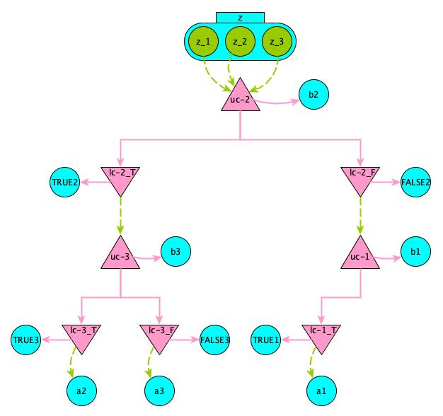
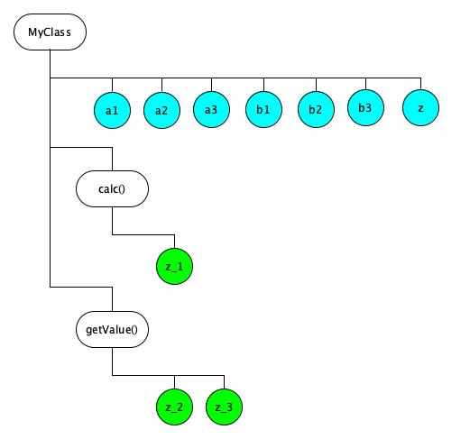
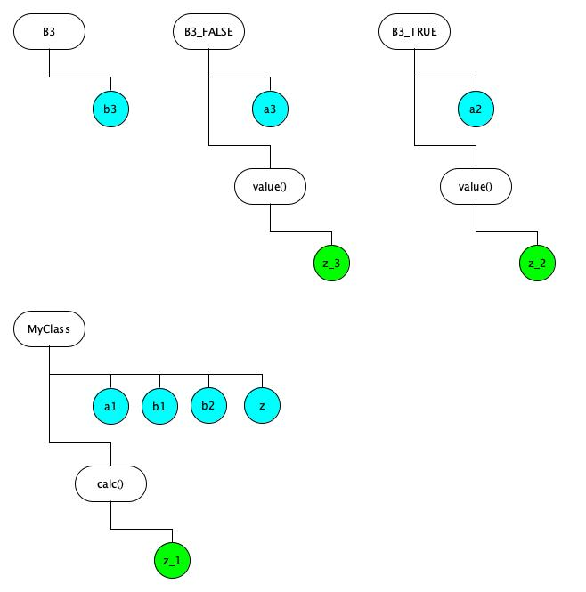
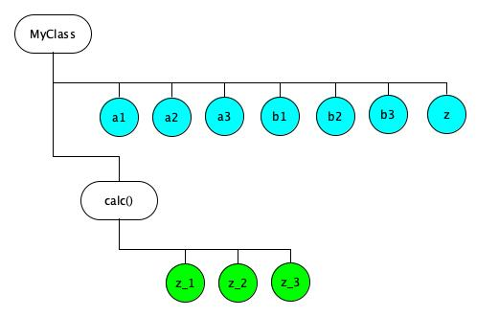
1: Distillation
DEPENDENCY
STRUCTURE
Notes:
Firstly, there is a stage which could be called software chromatography. This essentially distills the code that we are trying to analyse into two graphs, a dependency graph and a structural graph.
In our example I showed at the start of the presentation. Each of those three code snippets would be distilled into the exactly the same dependency graph but have different structural graph.

Slide 15
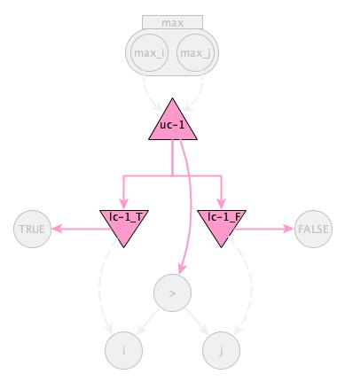
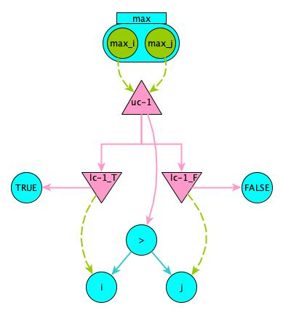
Dependency
Graph
Notes:
The dependency graph is described in more detail in the paper, but this example shows max function.
There are three elements to this. Firstly the conditional elements are the up and down triangles which represent the boolean dependencies.
The second are the purely functional structures. These are the expressions that contain operators and operands
And thirdly there are the assignment structures. These effectively detail the relationship between a variable and parameters. They also include any conditional elements in a Boolean normalized form.
The guiding aim for choosing these three elements, is to create a normalised dependency graph. This will allow us to easily determine isomorphism between two dependency graphs that produce similar behaviour.
A shorthand notation is also available,

Slide 16
Dependency
Graph
Conditional
Notes:
The dependency graph is described in more detail in the paper, but this example shows max function.
There are three elements to this. Firstly the conditional elements are the up and down triangles which represent the boolean dependencies.
The second are the purely functional structures. These are the expressions that contain operators and operands
And thirdly there are the assignment structures. These effectively detail the relationship between a variable and parameters. They also include any conditional elements in a Boolean normalized form.
The guiding aim for choosing these three elements, is to create a normalised dependency graph. This will allow us to easily determine isomorphism between two dependency graphs that produce similar behaviour.
A shorthand notation is also available,

Slide 17
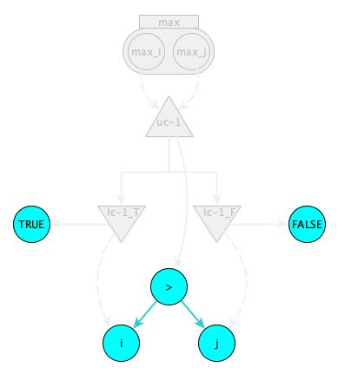
Dependency
Graph
Functional
Notes:
The dependency graph is described in more detail in the paper, but this example shows max function.
There are three elements to this. Firstly the conditional elements are the up and down triangles which represent the boolean dependencies.
The second are the purely functional structures. These are the expressions that contain operators and operands
And thirdly there are the assignment structures. These effectively detail the relationship between a variable and parameters. They also include any conditional elements in a Boolean normalized form.
The guiding aim for choosing these three elements, is to create a normalised dependency graph. This will allow us to easily determine isomorphism between two dependency graphs that produce similar behaviour.
A shorthand notation is also available,

Slide 18
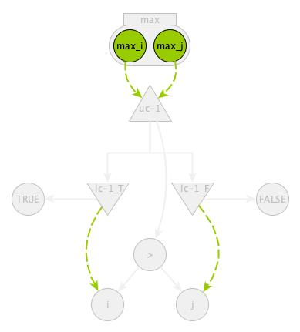
Dependency
Graph
Assignment
Notes:
The dependency graph is described in more detail in the paper, but this example shows max function.
There are three elements to this. Firstly the conditional elements are the up and down triangles which represent the boolean dependencies.
The second are the purely functional structures. These are the expressions that contain operators and operands
And thirdly there are the assignment structures. These effectively detail the relationship between a variable and parameters. They also include any conditional elements in a Boolean normalized form.
The guiding aim for choosing these three elements, is to create a normalised dependency graph. This will allow us to easily determine isomorphism between two dependency graphs that produce similar behaviour.
A shorthand notation is also available,

Slide 19
Dependency
Graph
Conditional
{uc-1 => “>”, lc-1_T => “TRUE”, lc-1_F => “FALSE”}
Functional
f(i,j) -> {“>” => i, “>” => j}
Assignments
max => {max_i, max_j}
max_i -> [i, {lc-1_T}]
max_j -> [j, {lc-1_F}]
Notes:
The dependency graph is described in more detail in the paper, but this example shows max function.
There are three elements to this. Firstly the conditional elements are the up and down triangles which represent the boolean dependencies.
The second are the purely functional structures. These are the expressions that contain operators and operands
And thirdly there are the assignment structures. These effectively detail the relationship between a variable and parameters. They also include any conditional elements in a Boolean normalized form.
The guiding aim for choosing these three elements, is to create a normalised dependency graph. This will allow us to easily determine isomorphism between two dependency graphs that produce similar behaviour.
A shorthand notation is also available,

Slide 20
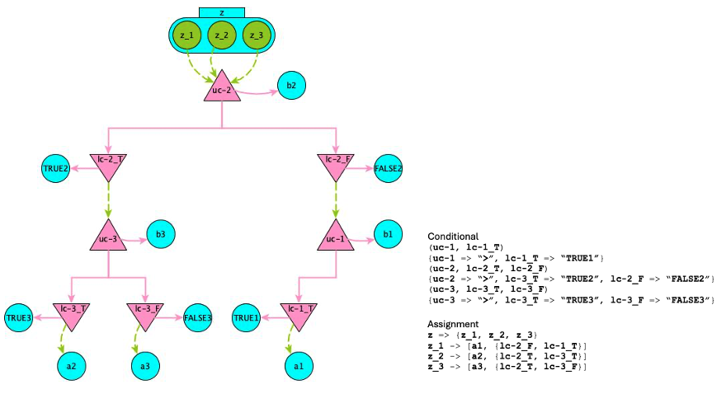
Code snippet dependency graph
Notes:
For interest, this is the dependency graph of the code snippets example

Slide 21
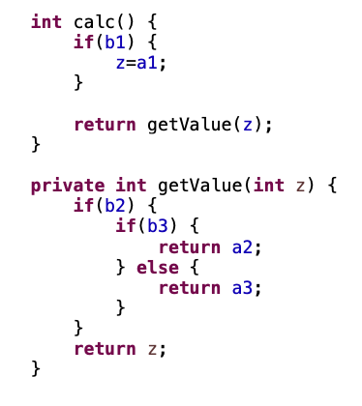
Structural Graph
Notes:
The structural graph also contains the variables and assignment expressions that appear in the dependency graph.
Here, though, they are placed in the structural elements of the language. Such as the method, class, package etc.

Slide 22
2 : Library of Alternative Structures
.
.
.
,
,
.
.
.
Notes:
The second stage would involve using a library of alternative designs. The library would contain a number of dependency sub graphs and for each of those a number of alternative structural representations of that dependency graph.
So, in our code snippet example, the Library would contain the dependency graph of z with its constituent parameters (a1 etc.). Mapped to that dependency graph would be the three structural graphs that each of the three alternatives use.
In this stage each of the dependency sub-graphs in the Library would be taken, in turn, to determine if it exists in the code to be analysed. If so, the alternative structural representations would be applied to the code. And the chunking penalty function would determine if it’s an improvement.
Before I briefly describe that function, it’s worth mentioning how we generate this Library. The idea is that we can use the distillation mechanisms to analyse open source code to identify common dependency sub-graphs and the different structures that have been employed across the codebases.

Slide 23
Chunking Penalty Function
Coupling – For each edge between two variables on the dependency graph, use a function of the distance between those variables in the structural graph.
Cohesion – For each pair of siblings in the structural graph, use a metric of the similarity of the pair on the dependency graph
Notes:
The chunking penalty function consists of two parts ;- coupling and cohesion. In both cases a distance function is used on one graph for pairs of nodes that are close on the other graph.

Slide 24
Analysing Open Source
Significant dataset allows for correlation
Gentner’s Systematicity Principle - higher order predicates enforce connections among lower order predicates.
Expert vs Novice - high vs low number of commits
Notes:
Round up….
(Gentner’s Systematicity principle9 )
Gentner D. Structure-mapping:a theoretical framework for analogy. Cognitive Science 1983, 7:155–170.
Higher-order relations play an important role in analogy, as is discussed below.
N
system can be represented by an interconnected predicate structure in which higher-order predicates enforce connections among lower-order predicates.’

Slide 25


Thanks
Notes:
This is Thomas & Veronica Mullen, without who’s genes and support, none of this would be possible.
I’d like to thank the anonymous reviewers for there feedback. Also Mariana and the PPIG organizers for making this conference the success it is

